Slide 1

7/1/24, 12:52 PM
Vision Transformer
AN IMAGE IS WORTH 16X16 WORDS
TRANSFORMERS FOR IMAGE RECOGNITION AT SCALE
Piotr Mazurek

Slide 2
7/1/24, 12:52 PM
Vision Transformer
PRESENTATION PLAN
Overview
A brief history of transformers
Why using transformers for CV is complicated?
How Vision Transformer (ViT) works?
ViT performance in image classi cation
Critics, impact, and my predictions (the fun part)

Slide 3
7/1/24, 12:52 PM
Vision Transformer
ASSUMPTIONS
You know (the basics of) PyTorch
You understand the Transformer concept
You know (more less) how BERT works ([CLS] token)

Slide 4

7/1/24, 12:52 PM
Vision Transformer
OVERVIEW
Source: lucidrains/vit-pytorch

Slide 5
7/1/24, 12:52 PM
Vision Transformer
OVERVIEW
Divide an input image into 196 (14x14) small images of size (16x16) Treat it as embedding in NLP
Use it as an input for traditional transformer encoder (like in BERT) Use 12 transformer layers (Norm, Multi-head attention, etc.)
Take the last output, use it as input for Dense Layer with 1000 classes Voilà - you have a classi cation model

Slide 6
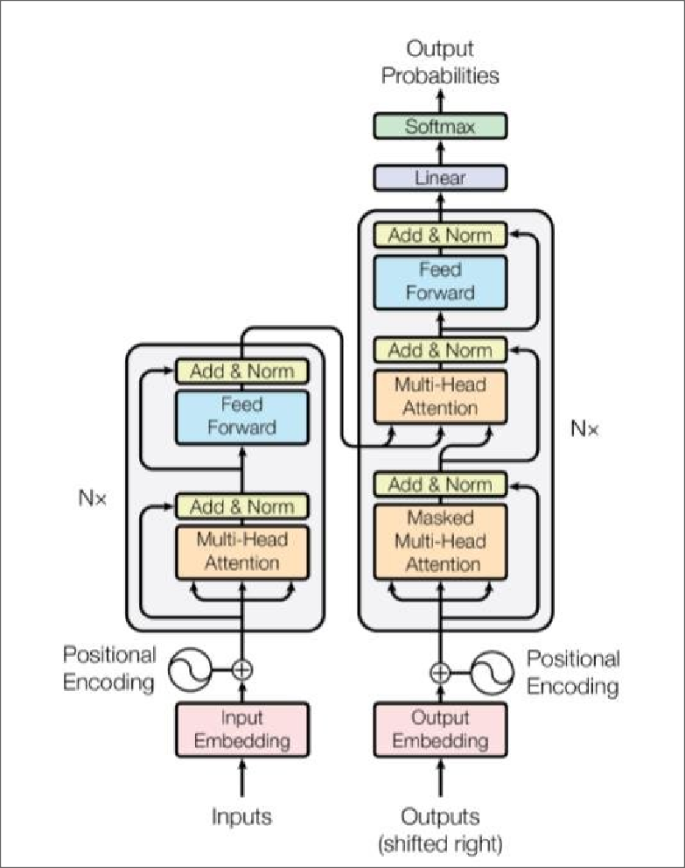
7/1/24, 12:52 PM
Vision Transformer
ATTENTION IS ALL YOU NEED
Source: Attention Is All You Need Vaswani et al. 2017

Slide 7
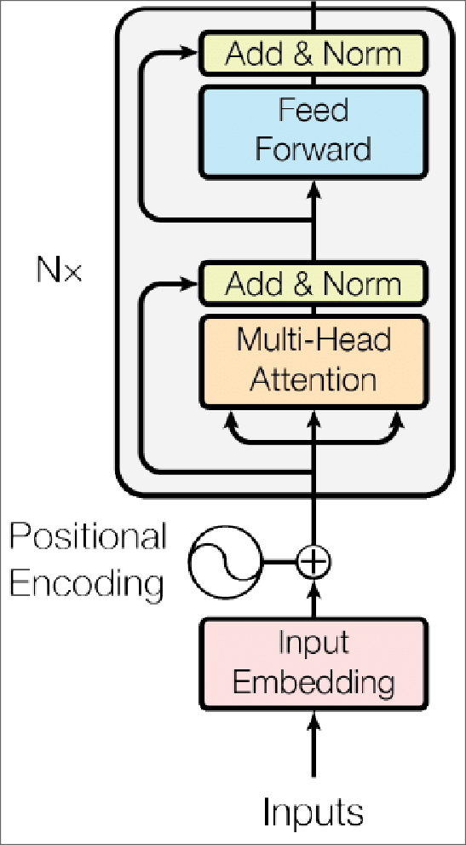
7/1/24, 12:52 PM
Vision Transformer
TRANSFORMER ENCODER
encoder_layer = nn.TransformerEncoderLayer(d_model=512,
nhead=8)
transformer_encoder = nn.TransformerEncoder(encoder_layer,
num_layers=6)

Slide 8
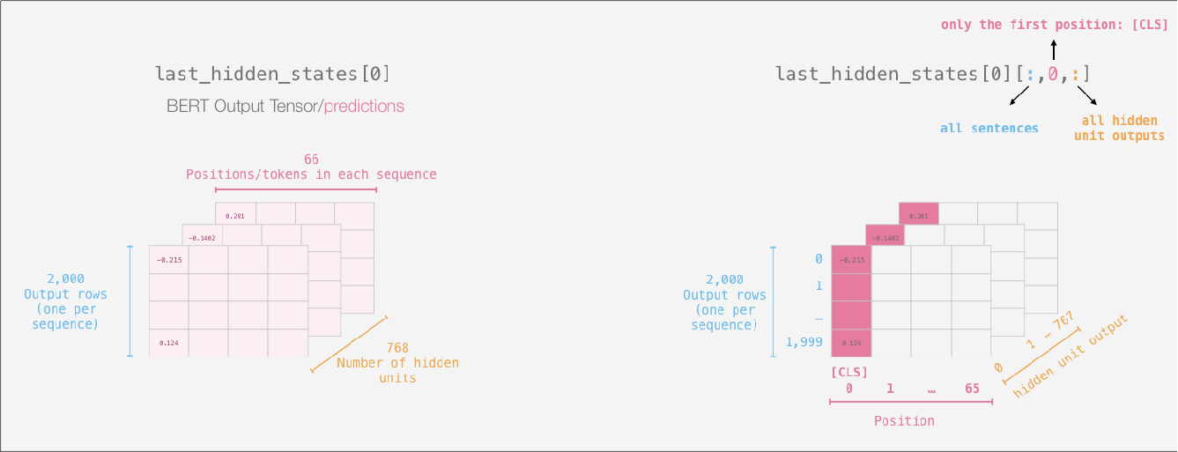
7/1/24, 12:52 PM
Vision Transformer
BERT
Source: A Visual Guide to Using BERT for the First Time Alammar 2020

Slide 9
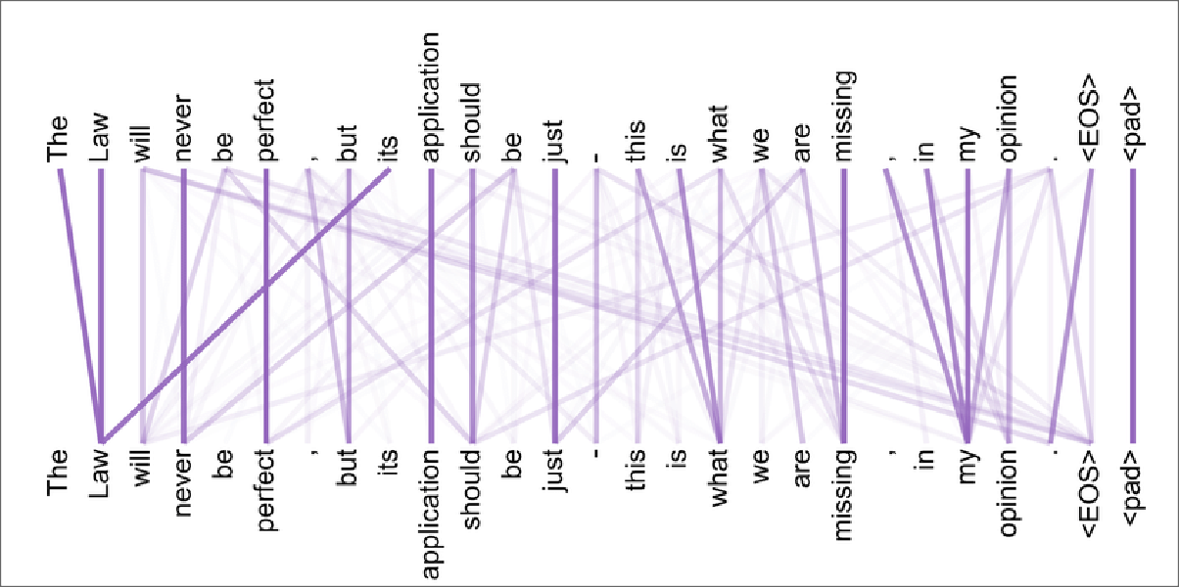
7/1/24, 12:52 PM
Vision Transformer
WHY DON'T WE USE A FULL IMAGE FOR TRANSFORMER?
Because complexity
We need to store n² parameters
(3 ∗ 224 ∗ 224)² = 22 billion parameters
Source: Deep Learning Based Chatbot Models Csaky 2017

Slide 10
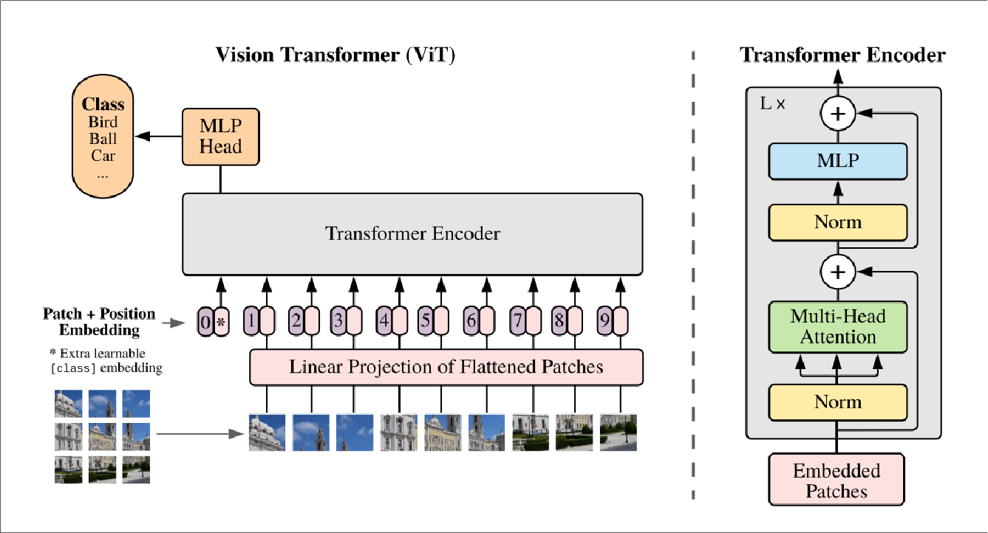
7/1/24, 12:52 PM
Vision Transformer
ARCHITECTURE RECAP
Source: Vision transformer paper Dosovitskiy et al. 2020

Slide 11
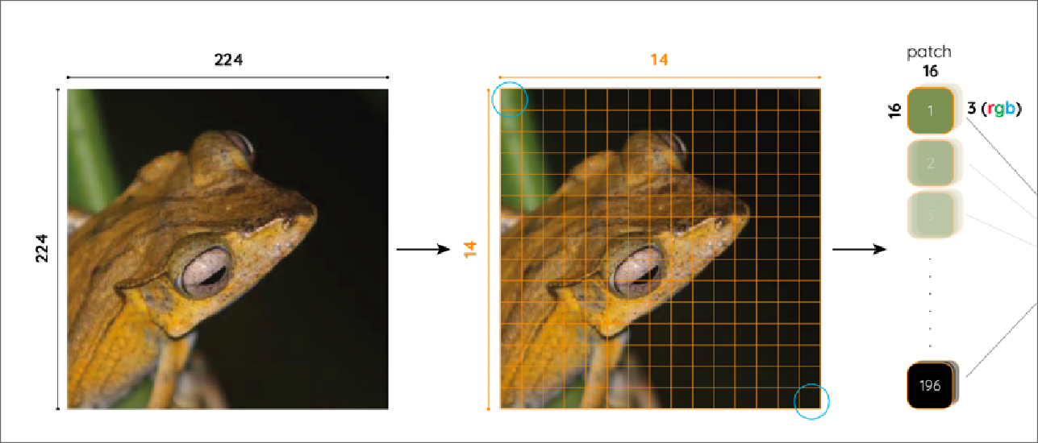
7/1/24, 12:52 PM
Vision Transformer
PATCH EMBEDDINGS
Image of size (3, 224, 224)
Divided into 196 (14 × 14) patches of size 3 × 16 × 16
D16*14 = 224 (original image size)
Source: Committed towards better future Bukhari 2021

Slide 12
7/1/24, 12:52 PM
Vision Transformer
PATCH EMBEDDINGS
Each patch is converted into a vector of size
3 × 16 × 16 = 768
So after that, we have 196 vectors of size 768, a matrix of size (196, 768)

Slide 13
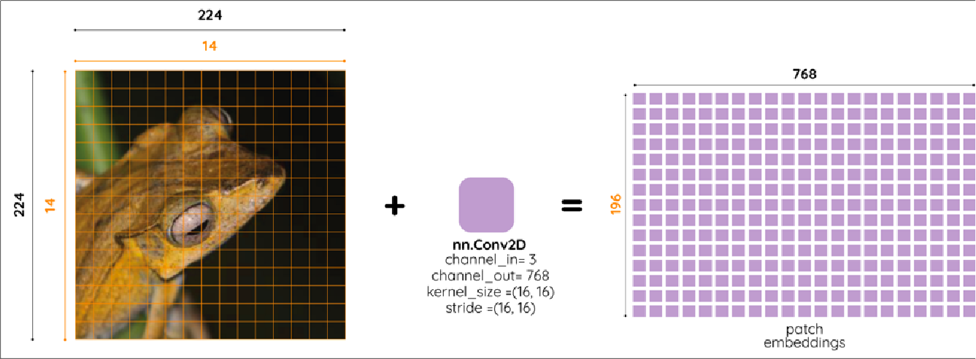
7/1/24, 12:52 PM
Vision Transformer
PATCH EMBEDDINGS
Source: Committed towards better future Bukhari 2021
x = torch.randn(1, 3, 224, 224)
# 2D conv
conv = nn.Conv2d(3, 768, 16, 16)
conv(x).reshape(-1, 196).transpose(0,1).shape
>> torch.Size([196, 768])

Slide 14
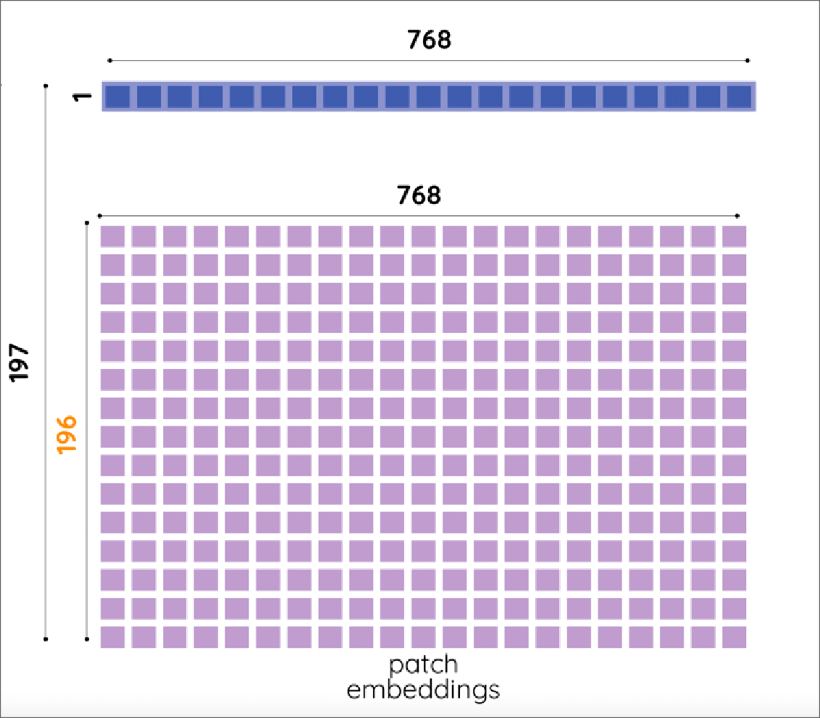
7/1/24, 12:52 PM
Vision Transformer
[CLS] TOKEN
Source: Committed towards better future Bukhari 2021
Similarly to the situation in BERT we need to add a [CLS] token
[CLS] token is a vector of size (1, 768)
The nal patch matrix has size (197, 768), 196 from patches and 1 [CLS] token

Slide 15
7/1/24, 12:52 PM
Vision Transformer
TRANSFORMER ENCODER RECAP
We have input embedding - patches matrix of size
(196, 768)
We still need position embedding

Slide 16
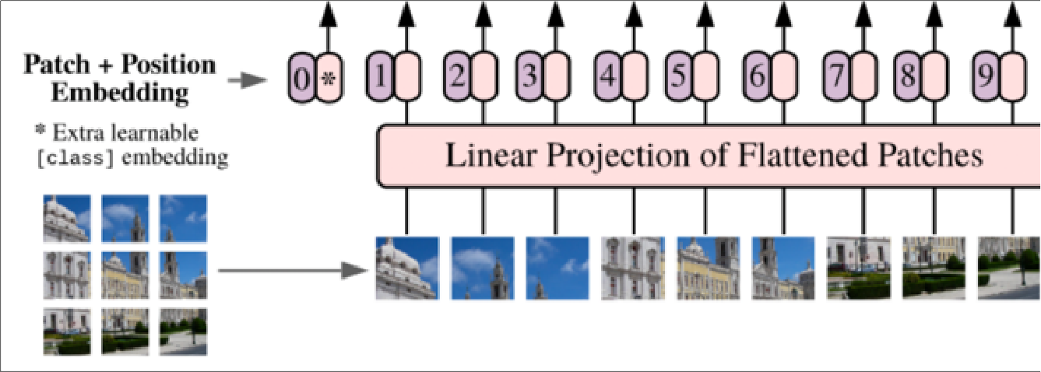
7/1/24, 12:52 PM
Vision Transformer
POSITION EMBEDDING
Source: Vision transformer paper Dosovitskiy et al. 2020
"We use standard learnable 1D position embeddings and the resulting sequence of embedding vectors serves as input to the encoder"

Slide 17
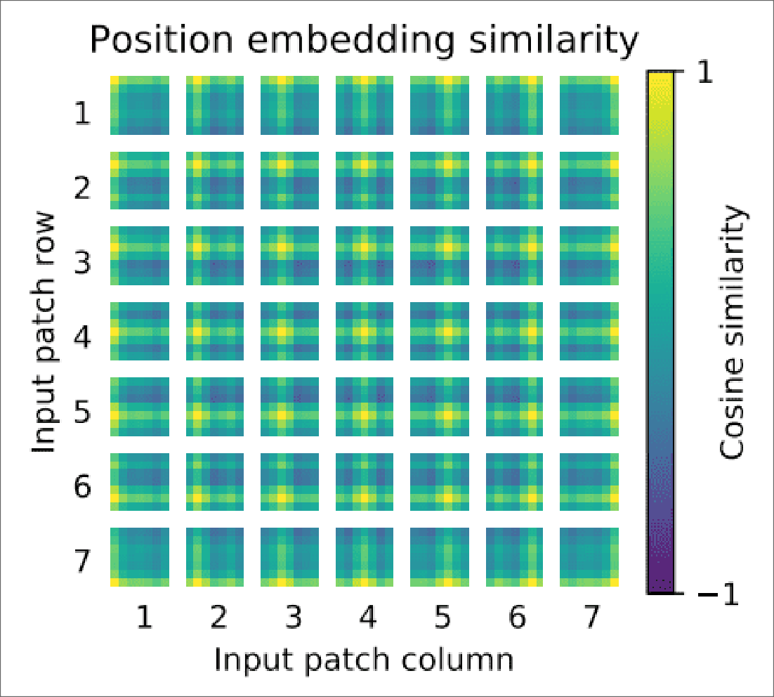
7/1/24, 12:52 PM
Vision Transformer
POSITION EMBEDDING SIMILARITIES
Source: Vision transformer paper Dosovitskiy et al. 2020

Slide 18
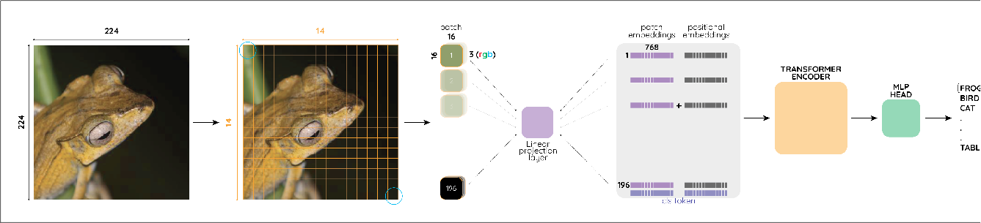
7/1/24, 12:52 PM
Vision Transformer
VISION TRANSFORMER PUT TOGETHER
Source: Committed towards better future Bukhari 2021

Slide 19
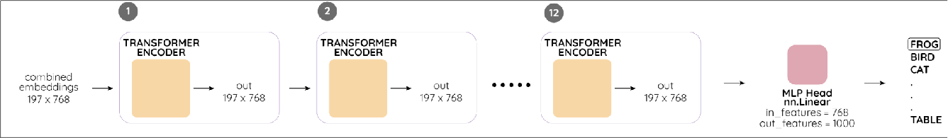
7/1/24, 12:52 PM
Vision Transformer
TRANSFORMER LAYERS
Source: Committed towards better future Bukhari 2021

Slide 20
7/1/24, 12:52 PM
Vision Transformer
END-TO-END TRAINING
class ViT(pl.LightningModule):
def init (self, num_transformer_layers, num_classes=1000): super(). init ()
self.criterion = nn.CrossEntropyLoss()
self.conv_embedding = nn.Conv2d(3, 768, 16, 16)
self.cls_token = nn.Parameter(torch.zeros(1, 1, embed_dim)) encoder_layer = nn.TransformerEncoderLayer(d_model=768,
nhead=8)
self.transformer_encoder =
nn.TransformerEncoder(encoder_layer, num_layers=num_transformer_layers)
self.mlp_head = nn.Linear(768, num_classes)
self.position_embedding_layer = nn.Embedding(197, 768)
def forward(self, x):
batch_size = x.shape[0]
cls_tokens = self.cls_token.expand(batch_size, -1, -1)
#(batch_size, 196, 768)
patches_embedding = self.conv_embedding(x).reshape(-1, 196).transpose(0,1)
#(batch_size, 197, 768)
patches_embedding = torch.cat((cls_tokens, patches_embedding), dim=1)
#(batch_size, 197); 0, 0, ... 196, 196
positions = self._assign_positions_to_patches(
#(batch_size, 197, 768)
position_embedding = position_embedding_layer(positions)
#(batch_size, 197, 768)
final_embedding = patches_embedding + position_embedding
#(batch_size, 197, 768)
embedding_output = self.transformer_encoder(final_embedding)
#(batch_size, 768)
cls_vector = embedding_output[:, 0, :]
#(batch_size, num_classes)
return mlp_head(cls_vector)

Slide 21
7/1/24, 12:52 PM
Vision Transformer
def training_step(self, batch, batch_idx): x, y = batch
logits = self.forward(x)
loss = self.criterion(logits, y)
return loss

Slide 22
7/1/24, 12:52 PM
Vision Transformer
HOW GOOD IS VIT PERFORMANCE?
TL; DR
Worse than Resnet when trained just on ImageNet Performance improved when pre-trained on big (and I mean it) dataset
Pretrained outperforms much bigger CNNs

Slide 23
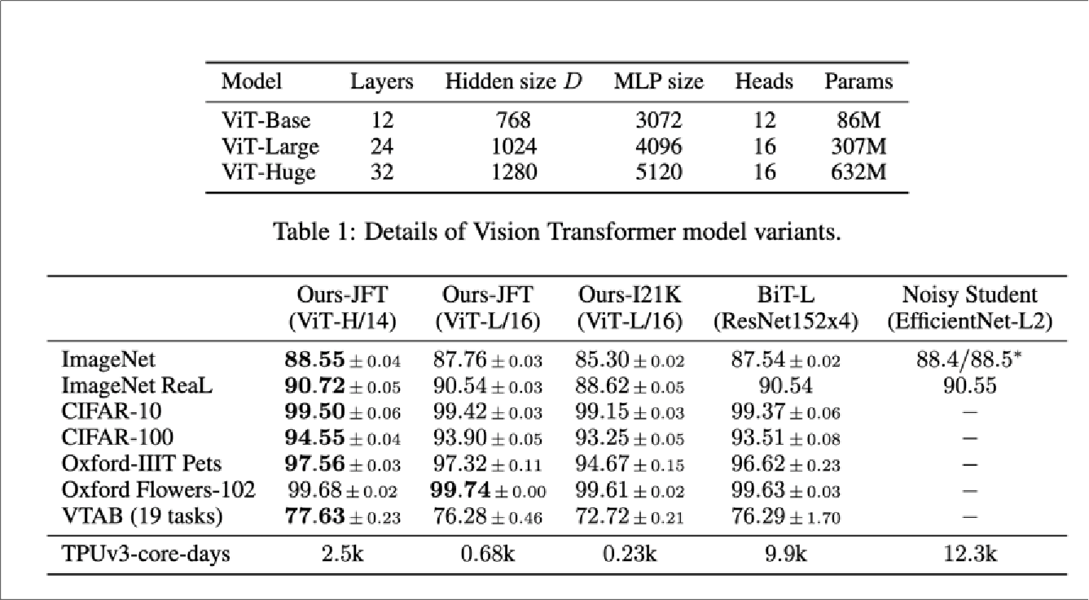
7/1/24, 12:52 PM
Vision Transformer
VIT IN NUMBERS
Source: Vision transformer paper Dosovitskiy et al. 2020

Slide 24
7/1/24, 12:52 PM
Vision Transformer
RULE OF THUMB
ARE YOU?
A FAANG company
A research lab with a budget equal to the GDP of a developing country
VIT MAY BE FOR YOU
OTHERWISE USE EFFICIENTNET, IT IS FINE
It takes 2.5k TPUv3 core days to train the best ViT model
At around USD 0.5 per core TPU/h, 2.5k*0.5*24h=USD 30,000

Slide 25
7/1/24, 12:52 PM
Vision Transformer
CRITICS
Better results - only with more data
The cost of training from scratch is ridiculously high (30k$) Is it really that di erent from Convolutions?

Slide 26
7/1/24, 12:52 PM
Vision Transformer
PAPER'S IMPACT
NEW PUNCHLINE: IS WORTH
An Image is Worth 16x16 Words, What is a Video Worth?
A Video Is Worth Three Views: Trigeminal Transformers for Video-based Person Re- identi cation

Slide 27
7/1/24, 12:52 PM
Vision Transformer
PAPER'S IMPACT
First time transformers outperform CNNs in CV
2021 - Year of transformers in CV?

Slide 28
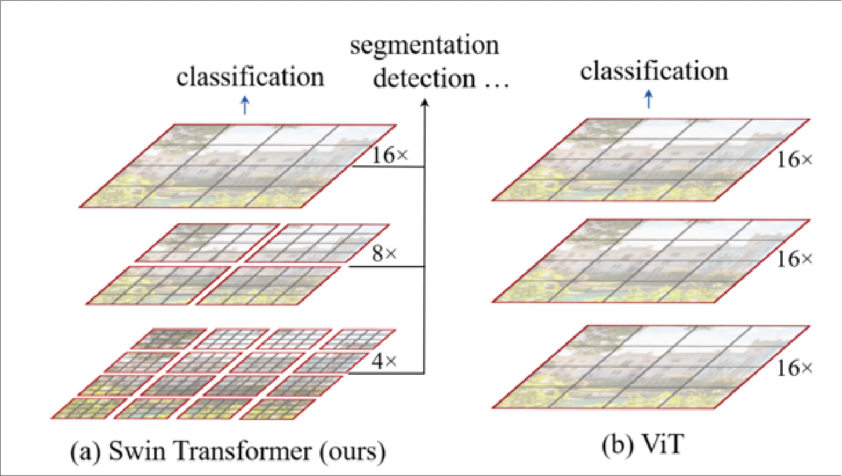
7/1/24, 12:52 PM
Vision Transformer
PAPER'S IMPACT
Already new, similar architectures have emerged
Source: Swin Transformer: Hierarchical Vision Transformer using Shifted Windows
Liu et al. 2021

Slide 29
7/1/24, 12:52 PM
Vision Transformer
PREDICTION #1
Transformers originally were seq2seq models, using ViT as a tool for captioning images is a "no-brainier"

Slide 30
7/1/24, 12:52 PM
Vision Transformer
PREDICTION #2
BERT like embedding for images - prototyping CV models drastically accelerated

Slide 31
7/1/24, 12:52 PM
Vision Transformer
PREDICTION #3
EVEN bigger models - even better image classi cation

Slide 32
7/1/24, 12:52 PM
Vision Transformer
PREDICTION #4
More sophisticated (yet e cient) approach for patches

Slide 33
7/1/24, 12:52 PM
Vision Transformer
THANKS
"Feel free to ask any question"
Piotr Mazurek
tugot17.github.io/Vision-Transformer-Presentation/

Slide 34
7/1/24, 12:52 PM
Vision Transformer
SELF ATTENTION
QUERY, VALUE, KEY
T
Attention(Q, K, V ) = softmax( ^{QK} )V
√d_{k}
For an input sequence of size n tokens in sequence with d embedding size
Q size: (n, d)
K^{T} size: (d, n)
Q size: (n, d)
QK^{T} : n² complexity softmax: n² complexity (QK^{T} )V n² complexity

